Slide 1
IPDP—Intellectual Property Disclosure Process
Technology Transfer and Economic Development

Slide 2
The New IP Disclosure Process Has Many Improved Features
Transparent
Faculty Input
Accelerated and Expedited
Commercialization and Dual Use Focused
Cost Effective and Efficient

Slide 3
When an Invention Disclosure is Submitted, It is First Reviewed for Prior Art
Invention Disclosure is submitted, and the submission is acknowledged within 48hrs (2bd); meeting is set up within 2 weeks
Conduct Prior Art Conflict Check
Conduct Commercialization Analysis
No, Drop
Yes, Move Forward

Slide 4
Next, the Method of Commercialization is Determined
Work with faculty to determine how the invention will be commercialized to benefit society
Consortium License
Work with Consortium
License
Work with TTED
Startup
I-Corps or Early-stage Accelerator
No, Drop
Yes, Move Forward

Slide 5
Next, the Faculty Provisional Group Decides Whether to Move Forward with Provisional
Consortium License
License
Startup
Yes, File NonProvisional Patent application
Faculty Provisional Group-Faculty Senate Nominations (Krishna Krishnamurthy, Pourya Shamsi), Mehdi Ferdowsi, Yue-Wern Huang, Dave Enke, Don Kelly, Kamal Khayat, Jerry Martin, Christine Karslake
No, Drop
Yes, File Provisional

Slide 6
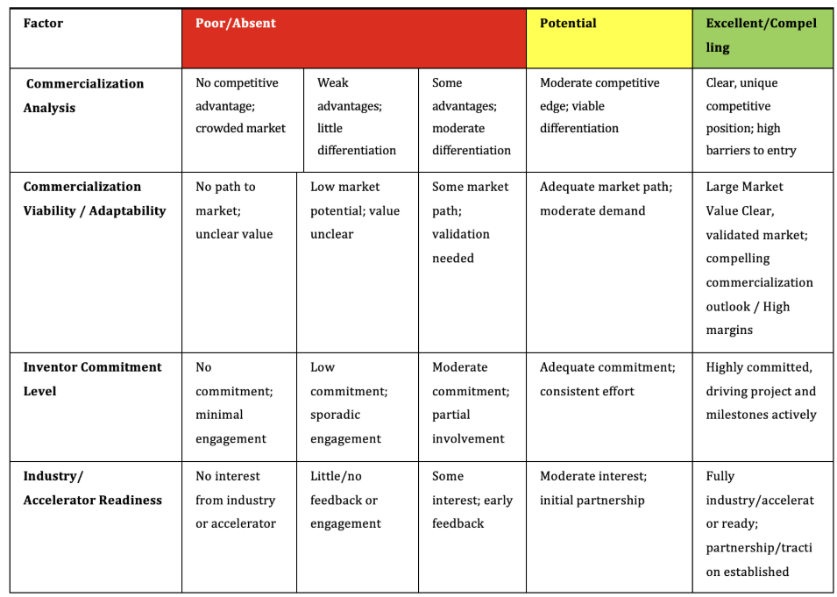
The Rubric Used by the Faculty Provisional Group is Simple and Straightforward
Notes:
Remove all numbers. Don mentioned this was potential problematic.

Slide 7
After a Provisional Patent Application is Made, There are 9 Months to Explore Commercialization
Early-stage accelerator
Develop strategic alternative pathways
Evaluate competitors
Identify key milestones
Assess market
Develop timelines
Analyze costs
Identify and evaluate risks
Summarize value creation
Craft strategy
Final competition
File Provisional
I-Corps
Principles of customer discovery
Interviewing techniques
Survey design
Identifying your value proposition
9 months
External legal completes patent application
3 months
File NonProvisional

Slide 8
If the Intention is to Move Forward with a License, We Enable Industry Engagement and Conversation
Industry Partner Ready
Yes, move forward
No
Industry Discovery with Conversations
No, Drop
Yes
Yes, move forward

Slide 9
Next, the Faculty NonProvisional Group Decides Whether to Move Forward with NonProvisional
License
Startup
Inventor presents to the Faculty NonProvisional Group to share their engagement activity and licensing status.
Faculty Provisional Group
No, Drop
Yes, File NonProvisional

Slide 10
The New IP Disclosure Process Will Integrate:
Transparency-transparent process and rubric
Faculty Input-faculty input from faculty senate, assoc. deans
Acceleration-able to file provisionals in shorter time, earlier USPTO date
Commercialization Focus-emphasis on licensing or startups
Cost Efficacy-good stewardship of financial resources
Notes:
IP budget – University financial resources

Slide 11
The New IP Disclosure Process Timeline
Receive Invention Disclosure
TTED Acknowledgement / Assignment of
MST Tech ID
TTED Meets with Inventors
Prior Art /Commercialization Analysis
Receive Commitment
File Provisional
Inventor Engagement Activity / Industry Partner Licensing
File Non-Provisional
Today
48 Hours
Two Weeks
Four Weeks
Six Weeks
Two Months
Nine Months
after Provisional/PCT
Twelve Months
after Provisional

Slide 12
Commercialization Analysis

Slide 13



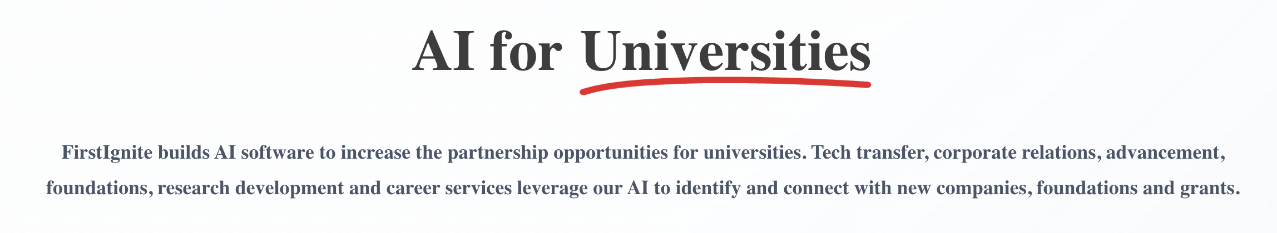




AI in the Commercialization Analysis

Slide 14
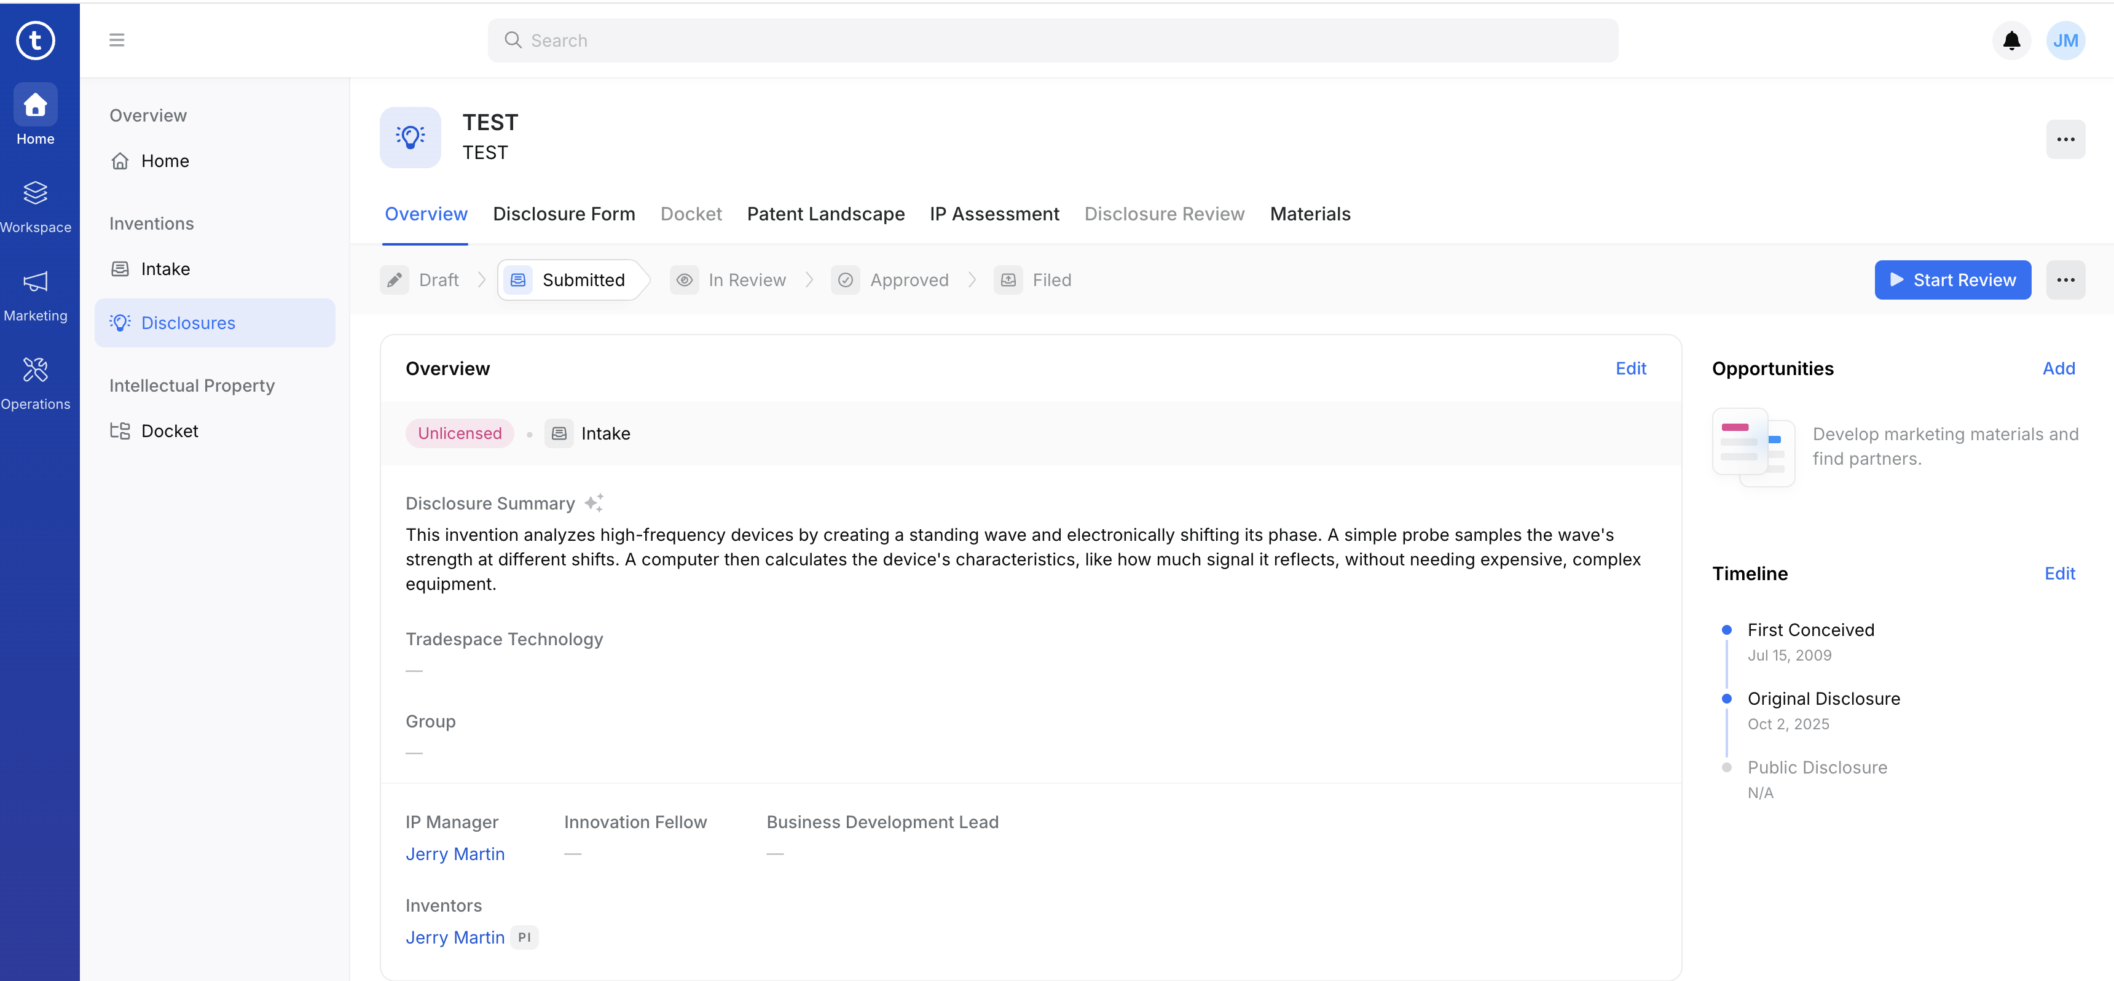
Tradespace AI Platform

Slide 15
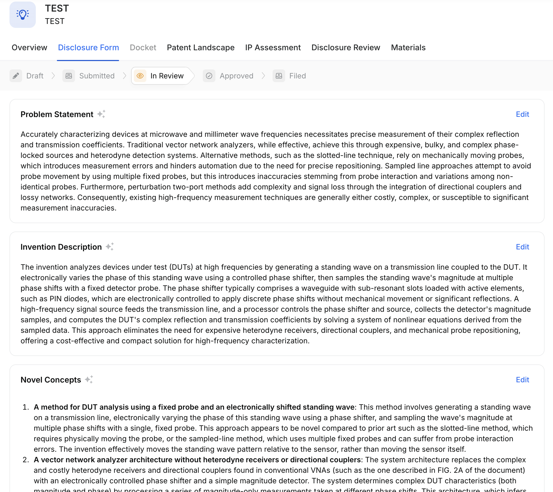
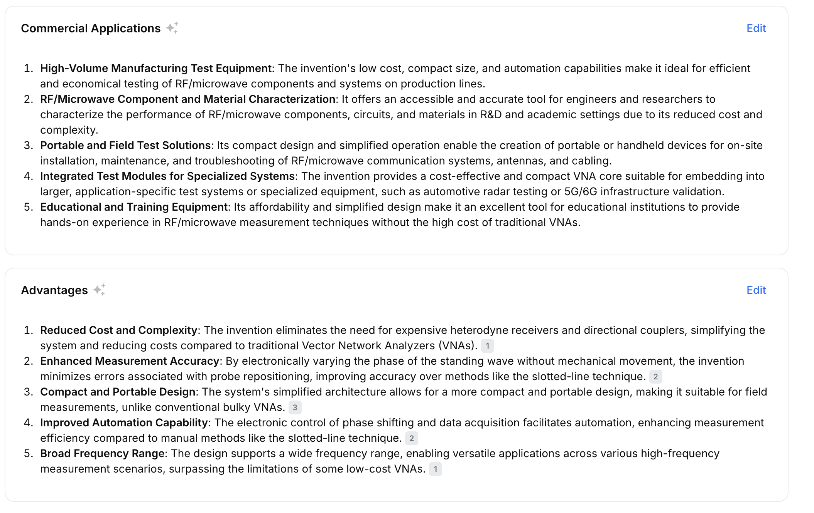
Tradespace AI Platform

Slide 16
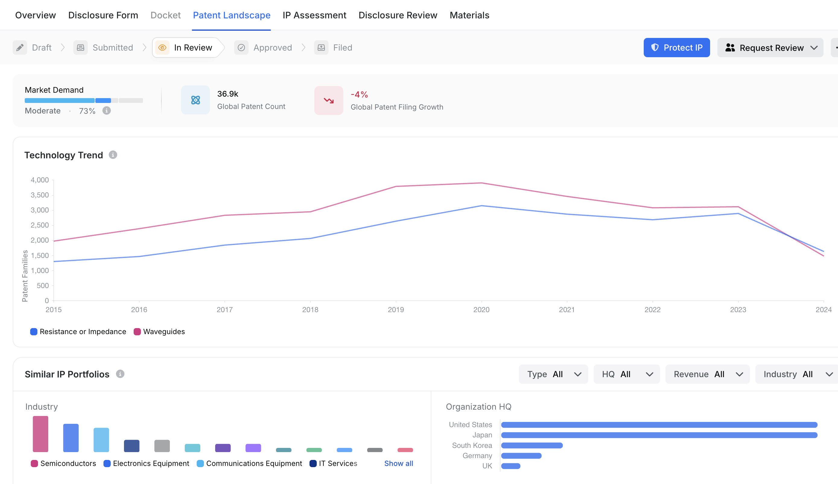
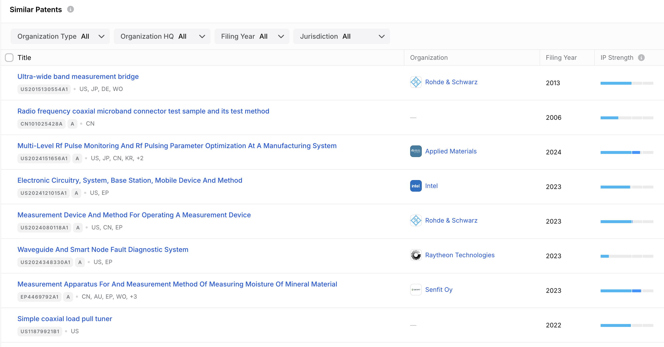
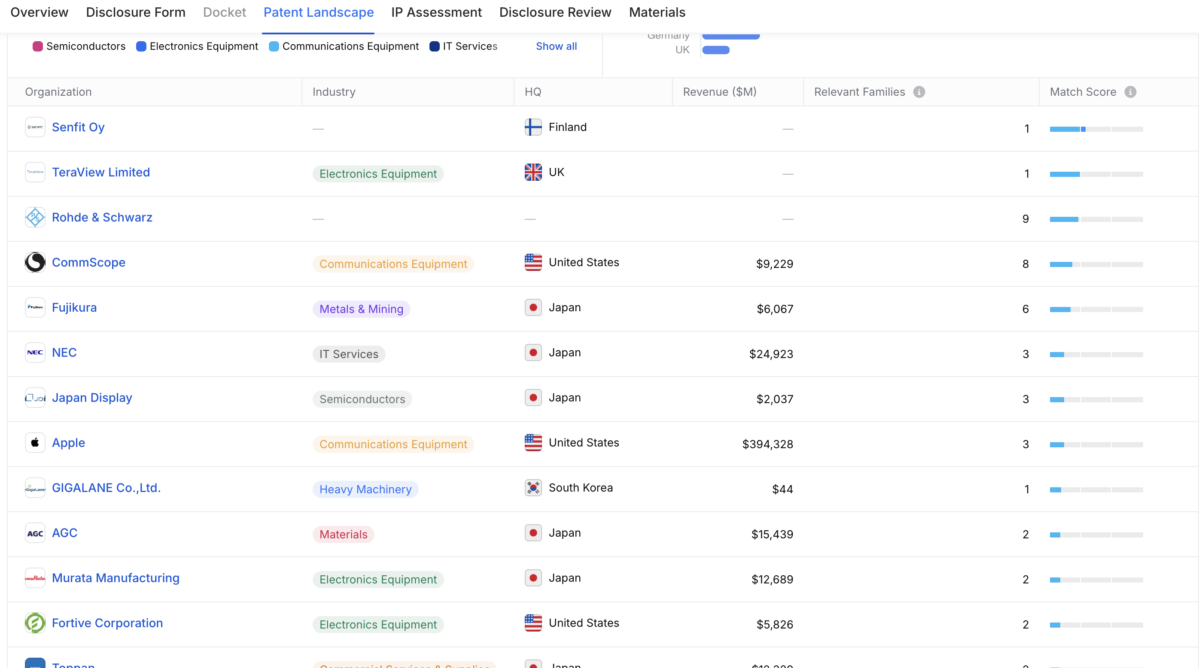
Tradespace AI Platform

Slide 17
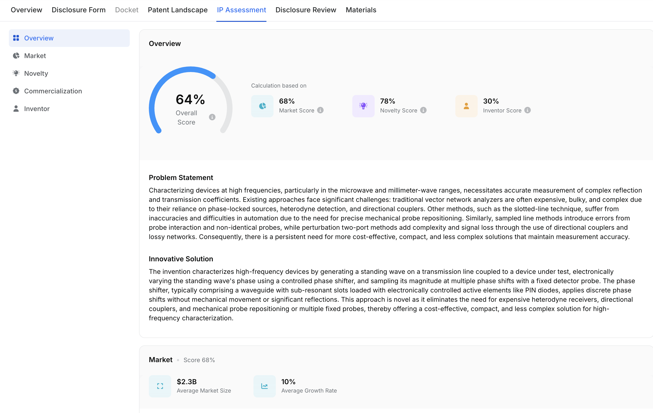
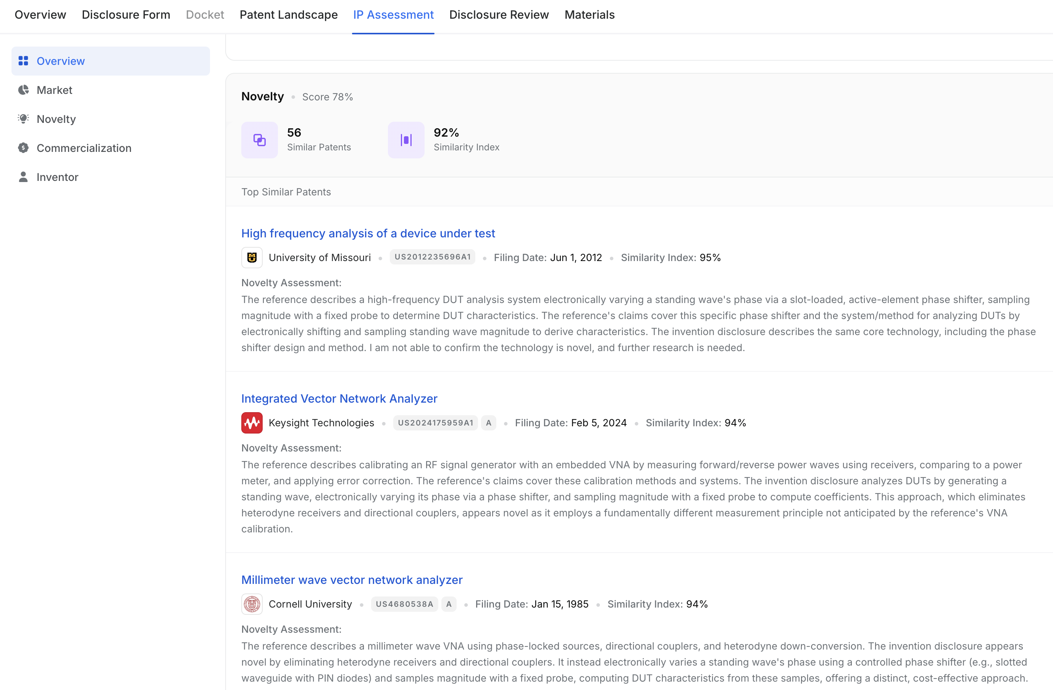
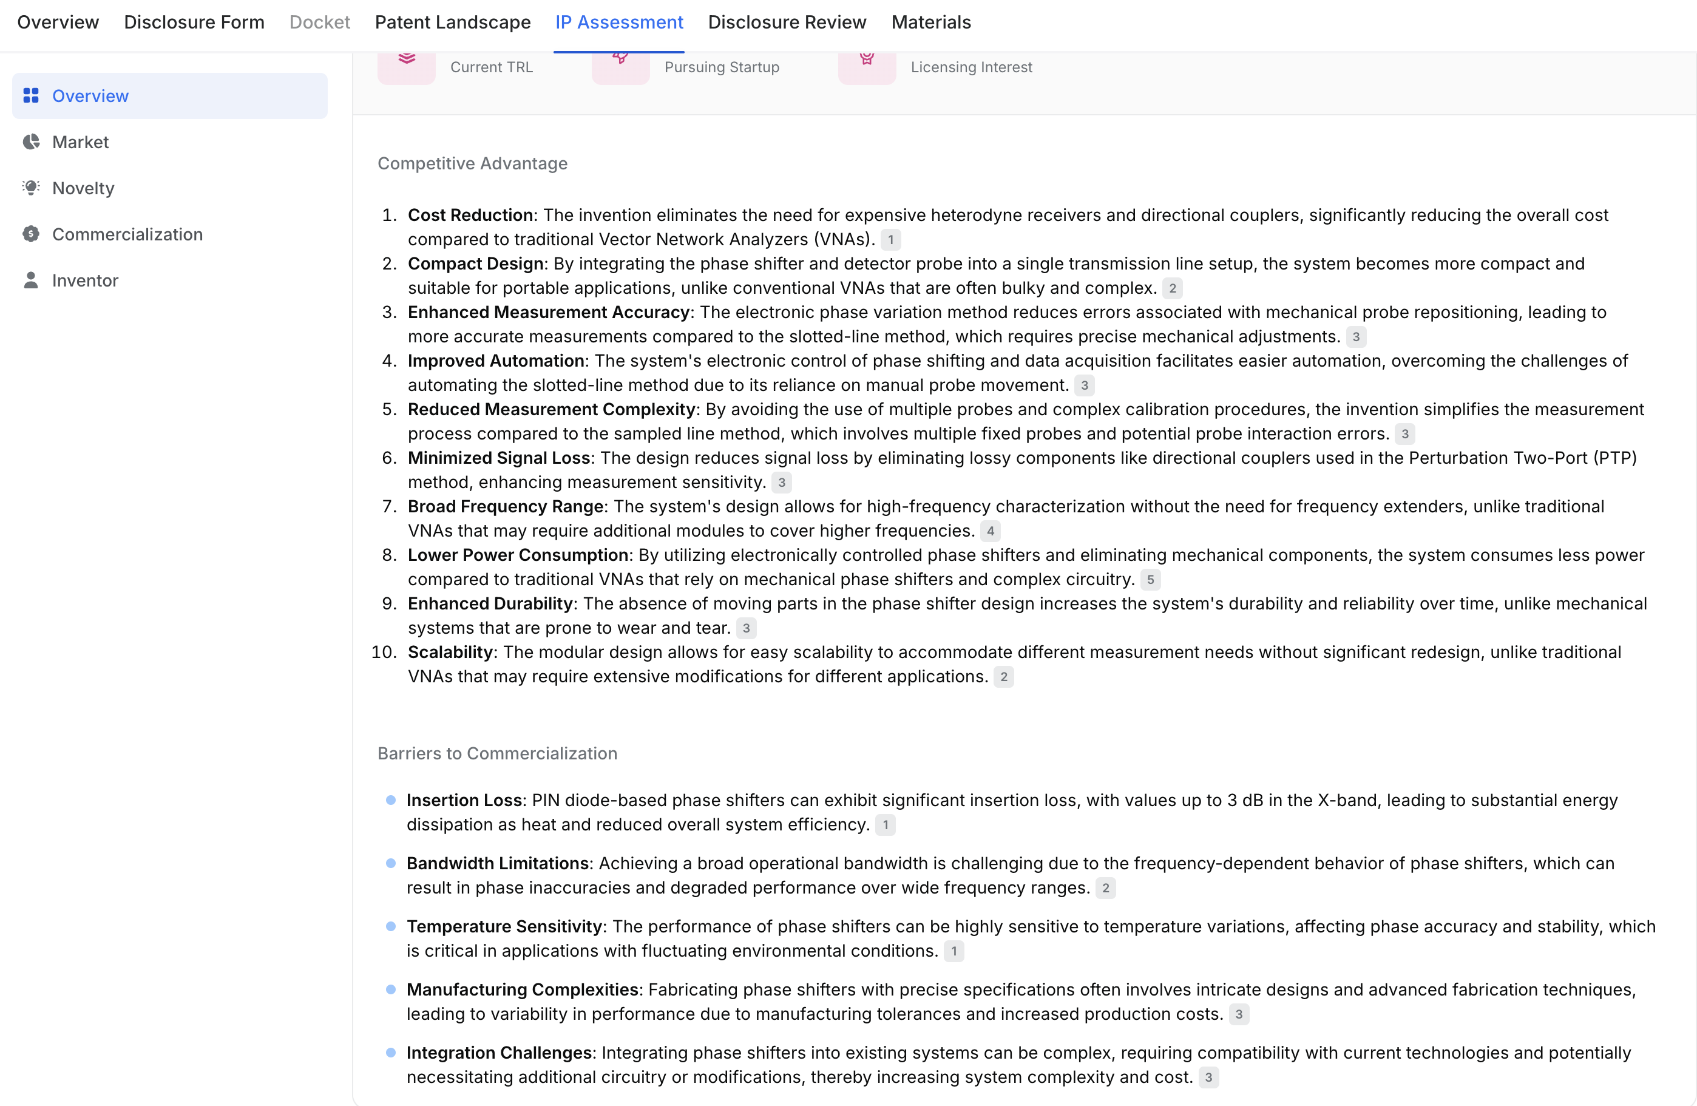
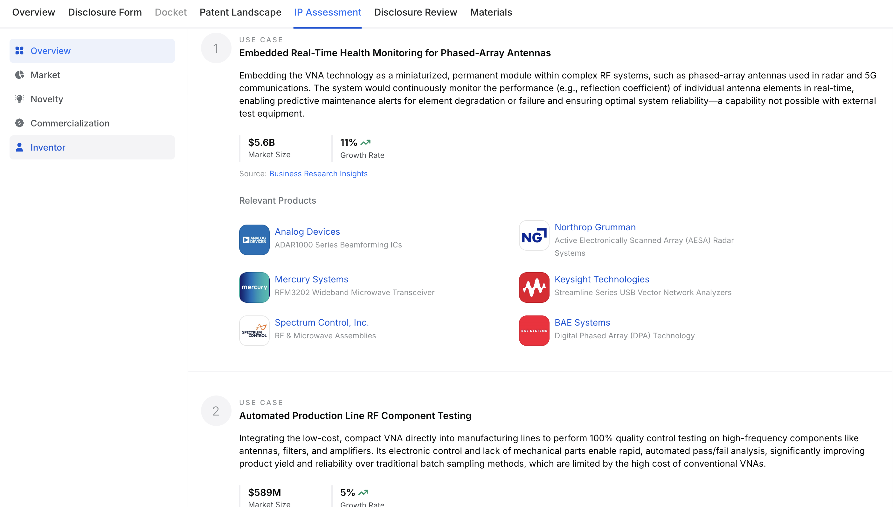
Tradespace AI Platform

Slide 18
Inventors’ Input - Commercialization Analysis
Inventors are the experts
Potential interested industries
Any industry introductions
Willingness to participate in the process
Invention is just a part of the entire innovation process
Celebrate issued patents, but the real value lies in the commercialization process and locking in licensing deals
Parter with TTED so we can create a win-win-win for the inventor, the University, and society

Slide 19
Thank You!
@ Christine Karslake, 2025

